Slide 1


CARBON EMISSIONS OF THE 12” WOVEN BOWL
OUR ARTISANS
OUR PRODUCTS
OUR MISSION
2024 Data Team: Bonaventure Masengesho, Leah Coe, Jakub Peczek, Meraaj Akhtar, Niyonkuru Sam, Ashley Parr, IQra Hussain, Dukundimana Toussaint, Kwisanga Dacia

Slide 2
WHAT ARE WE DOING HERE?
OUR ARTISANS
OUR PRODUCTS
OUR MISSION
WE WERE TASKED TO CALCULATE THE CARBON FOOTPRINT OF ONE OF THEIR MOST POPULAR PRODUCTS: 12" MEDIUM WOVEN BOWL.
THE FOOTPRINT CALCULATED WILL BE COMPARED TO THE FUEL-EFFICIENT STOVES AND WATER FILTER IMPACT PROJECTS TO ENSURE A POSITIVE CONTRIBUTION TO THE ENVIRONMENT.

Slide 3
RESEARCH AIMS...
OUR ARTISANS
OUR PRODUCTS
OUR MISSION
OUR AIM:
HOW MANY FILTERS AND STOVES NEED TO BE SOLD FOR THE 12" MEDIUM WOVEN BOWLS TO BECOME CARBON NEUTRAL?
TO DO THIS, WE BROKE IT DOWN INTO THREE QUESTIONS:
WHAT IS THE CARBON FOOTPRINT OF ONE 12” BOWL?
HOW MUCH CARBON IS SAVED BY WATER FILTERS?
HOW MUCH CARBON IS SAVED BY FUEL-EFFICIENT STOVES?

Slide 4
THE METHODOLOGY USED...
OUR ARTISANS
OUR PRODUCTS
OUR MISSION
BREAKDOWN OF PROCESSES
CREATING QUESTIONNAIRES
PILOT STUDY
REVISED QUESTIONNAIRES
GROUPS CHOSEN
INTERVIEWS
DATA PROCESSING

Slide 5
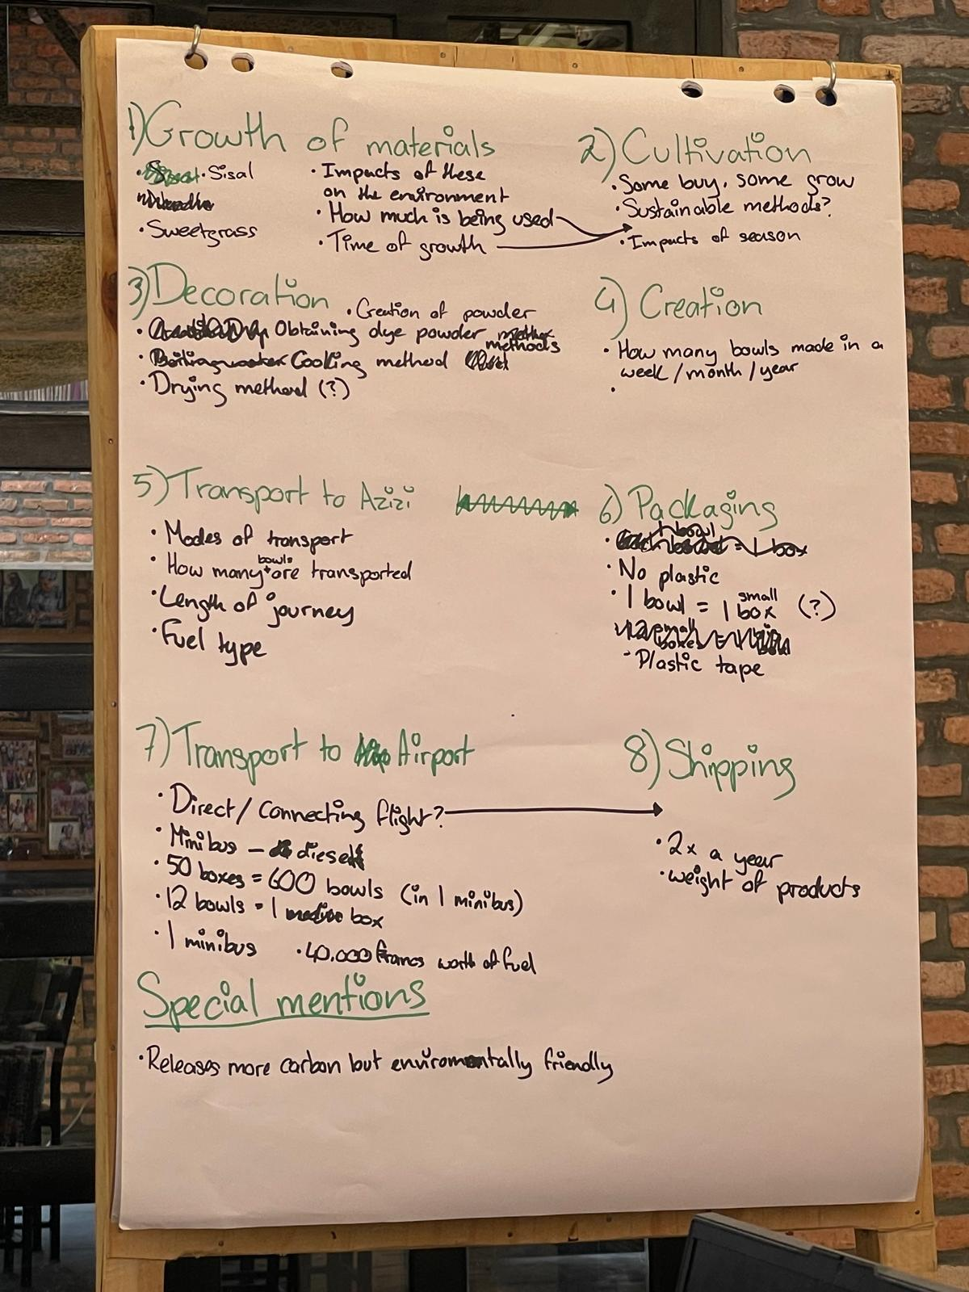
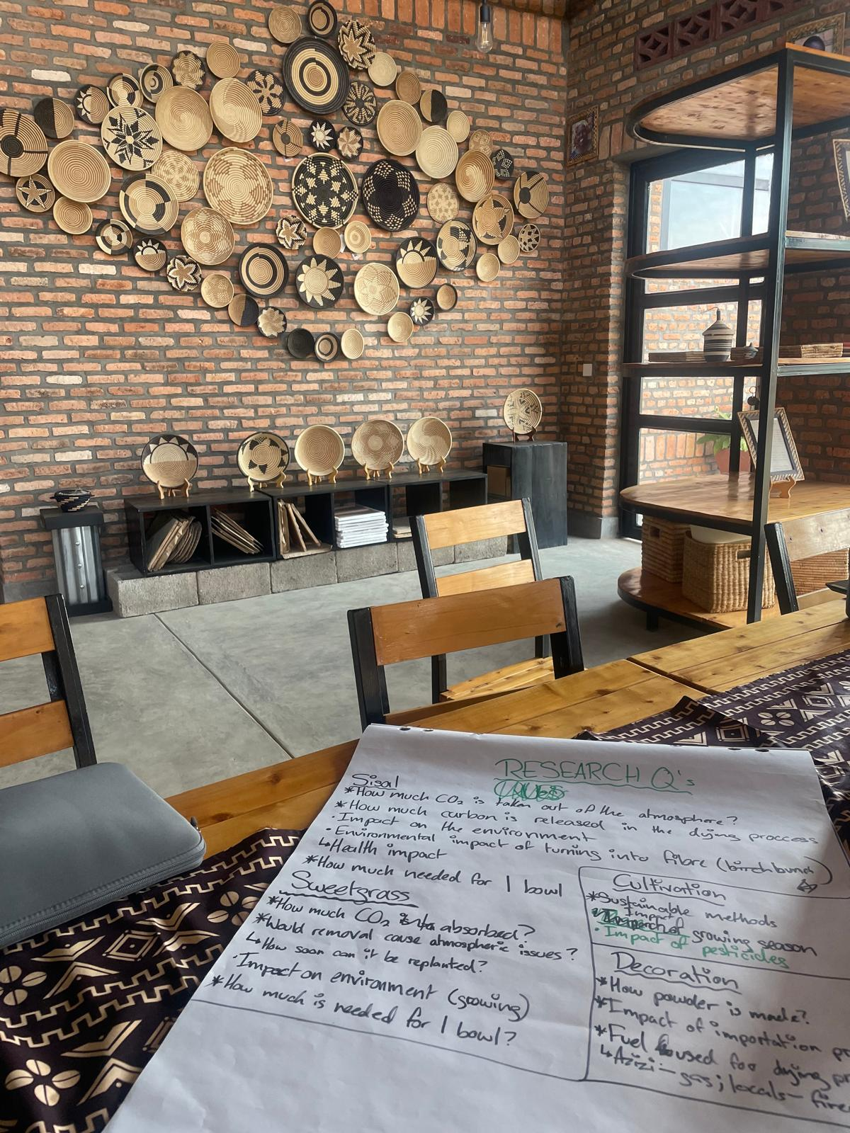
BREAKDOWN OF PROCESSES
OUR ARTISANS
OUR PRODUCTS
OUR MISSION
BEFORE CREATING THE QUESTIONNAIRES, WE HAD TO BREAKDOWN THE STEPS, TAKING A ‘CRADLE-TO-GATE’APPROACH.
SEPARATED INTO 8 ‘CATEGORIES’, ANY POTENTIAL FACTORS WITHIN THAT WOULD PRODUCE CARBON AND FURTHER SEPARATING THEM INTO PRIMARY AND SECONDARY RESEARCH.

Slide 6
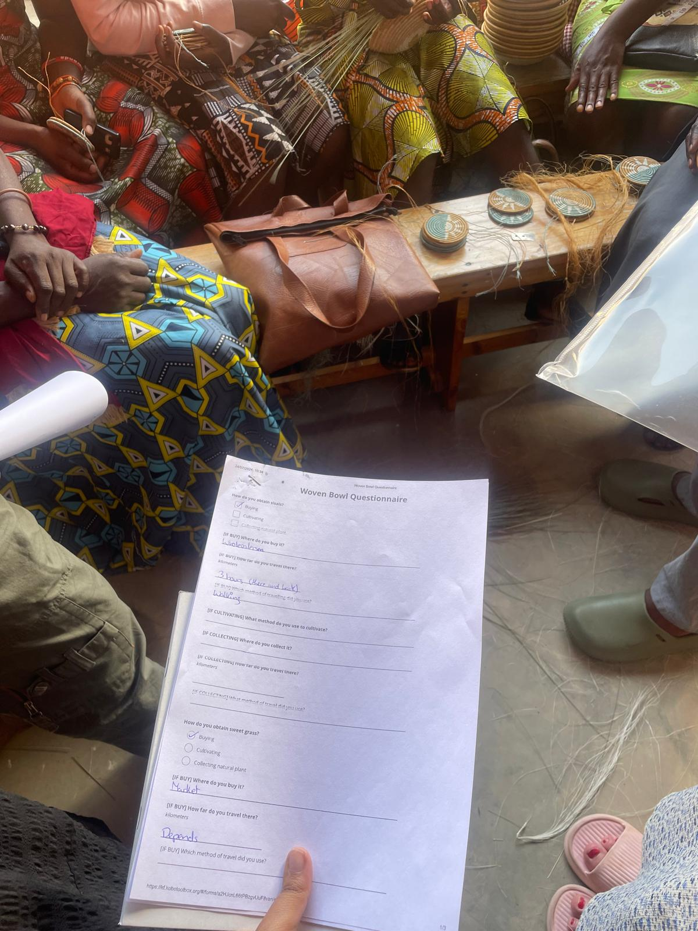
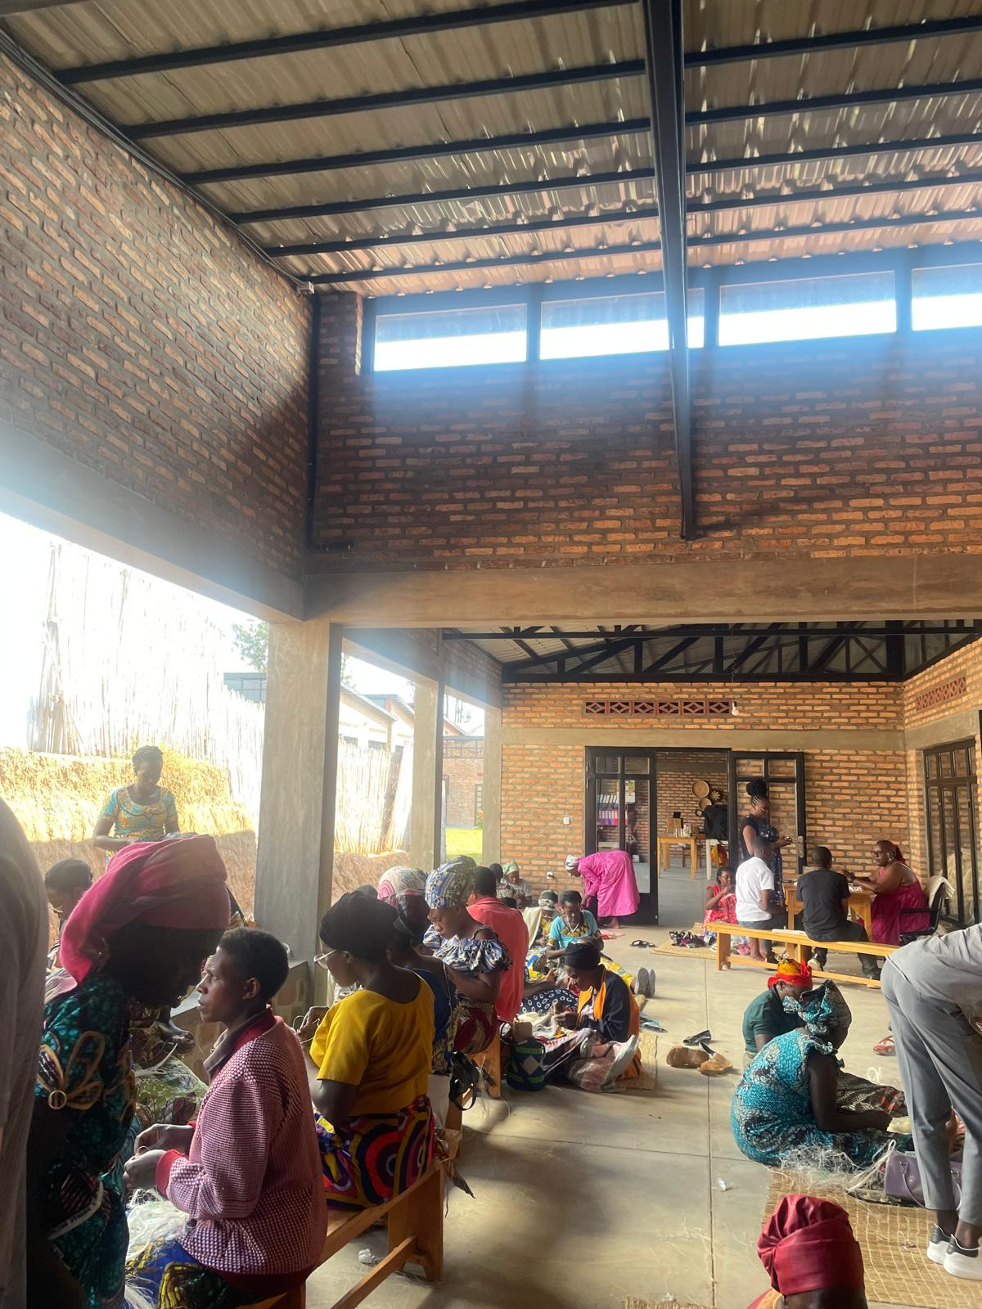
CREATING QUESTIONNAIRES
OUR ARTISANS
OUR PRODUCTS
OUR MISSION
BASED OFF THE CATEGORIES, WE CAME UP WITH A DRAFT FOR TWO QUESTIONNAIRES--ONE FOR THE WOVEN BOWLS AND ONE FOR THE STOVES AND FILTERS.
FROM THERE, WE CONDUCTED A PILOT STUDY WITH ARTISANS DELIVERING THEIR PRODUCTS.

Slide 7
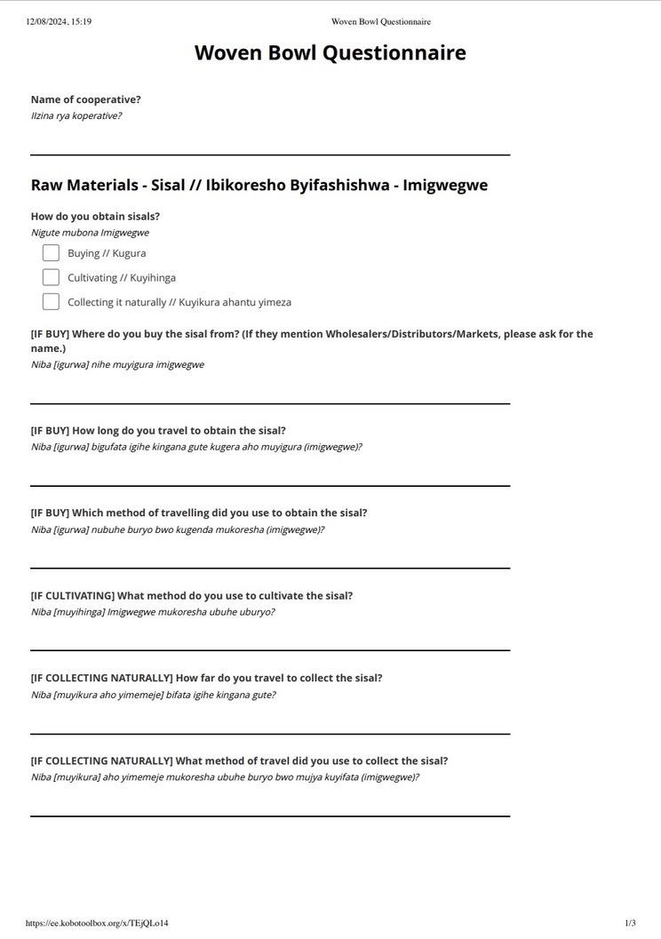
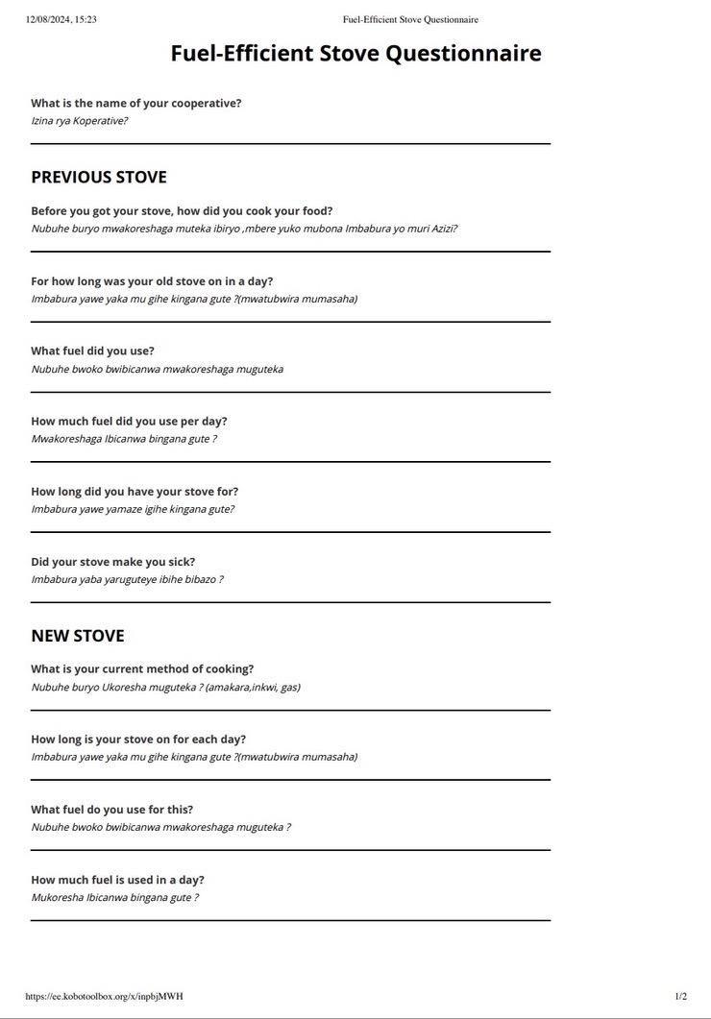
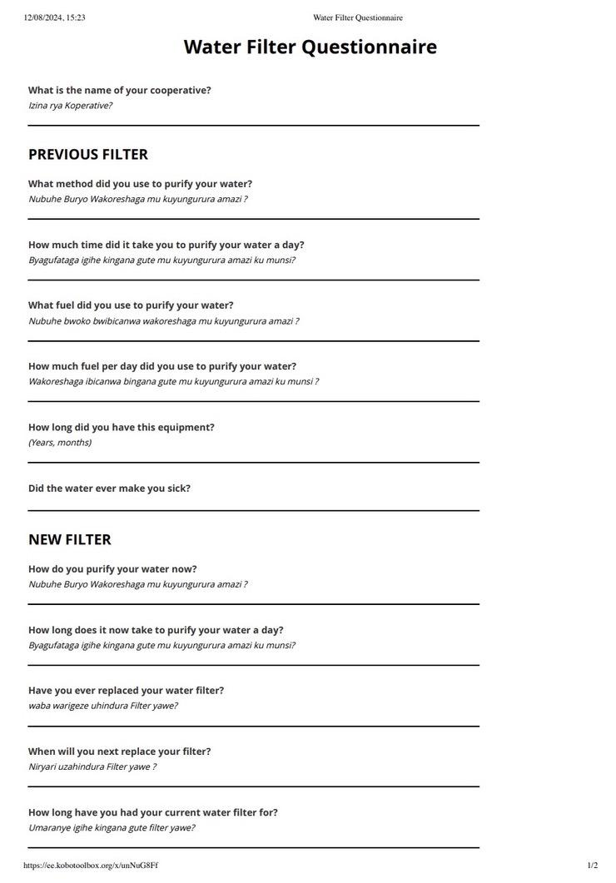

REVISED QUESTIONNAIRES
OUR ARTISANS
OUR PRODUCTS
OUR MISSION

Slide 8
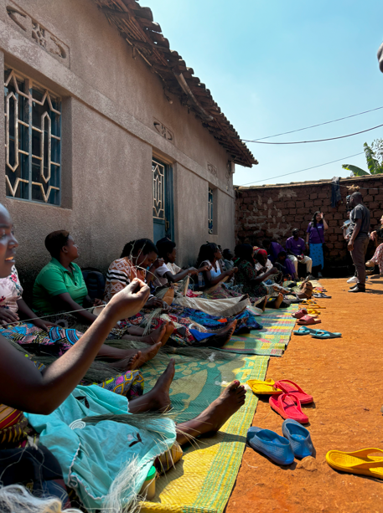
CHOOSING COOPERATIVES...
OUR ARTISANS
OUR PRODUCTS
OUR MISSION
OUR MAIN CRITERIA FOR PARTICIPANTS:
SPECIALISING IN WOVEN BOWLS
PROXIMITY TO AZIZI LIFE
AVAILABILITY

Slide 9
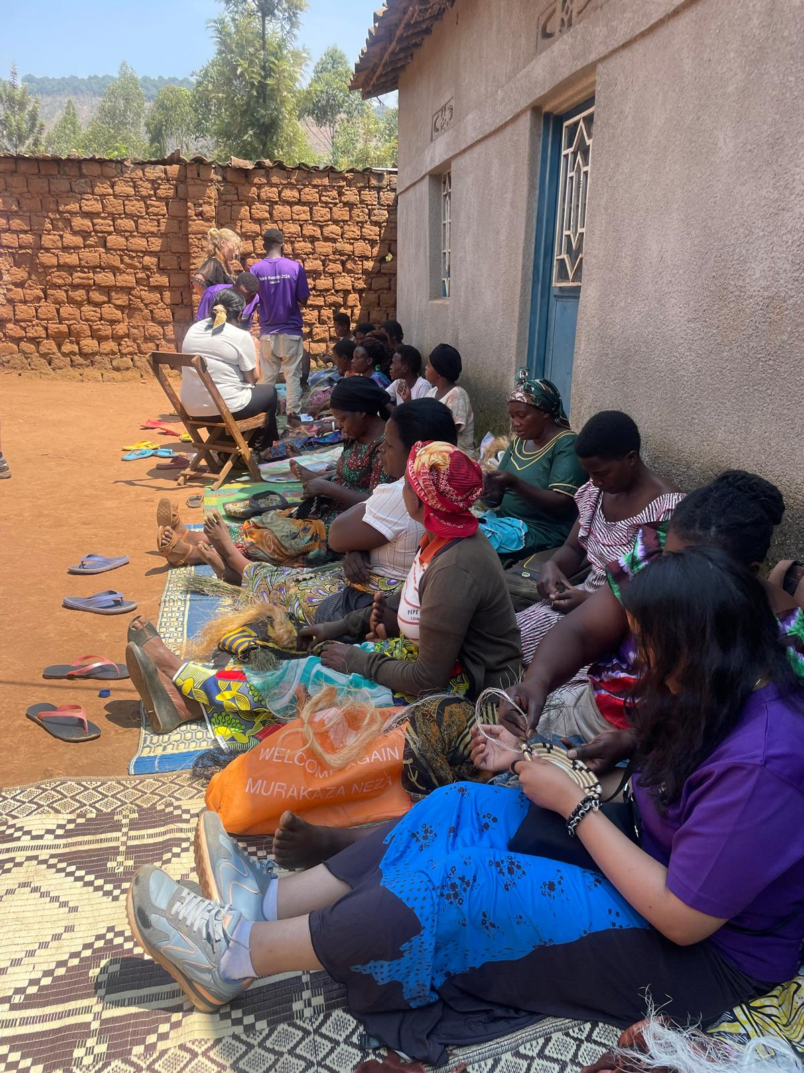
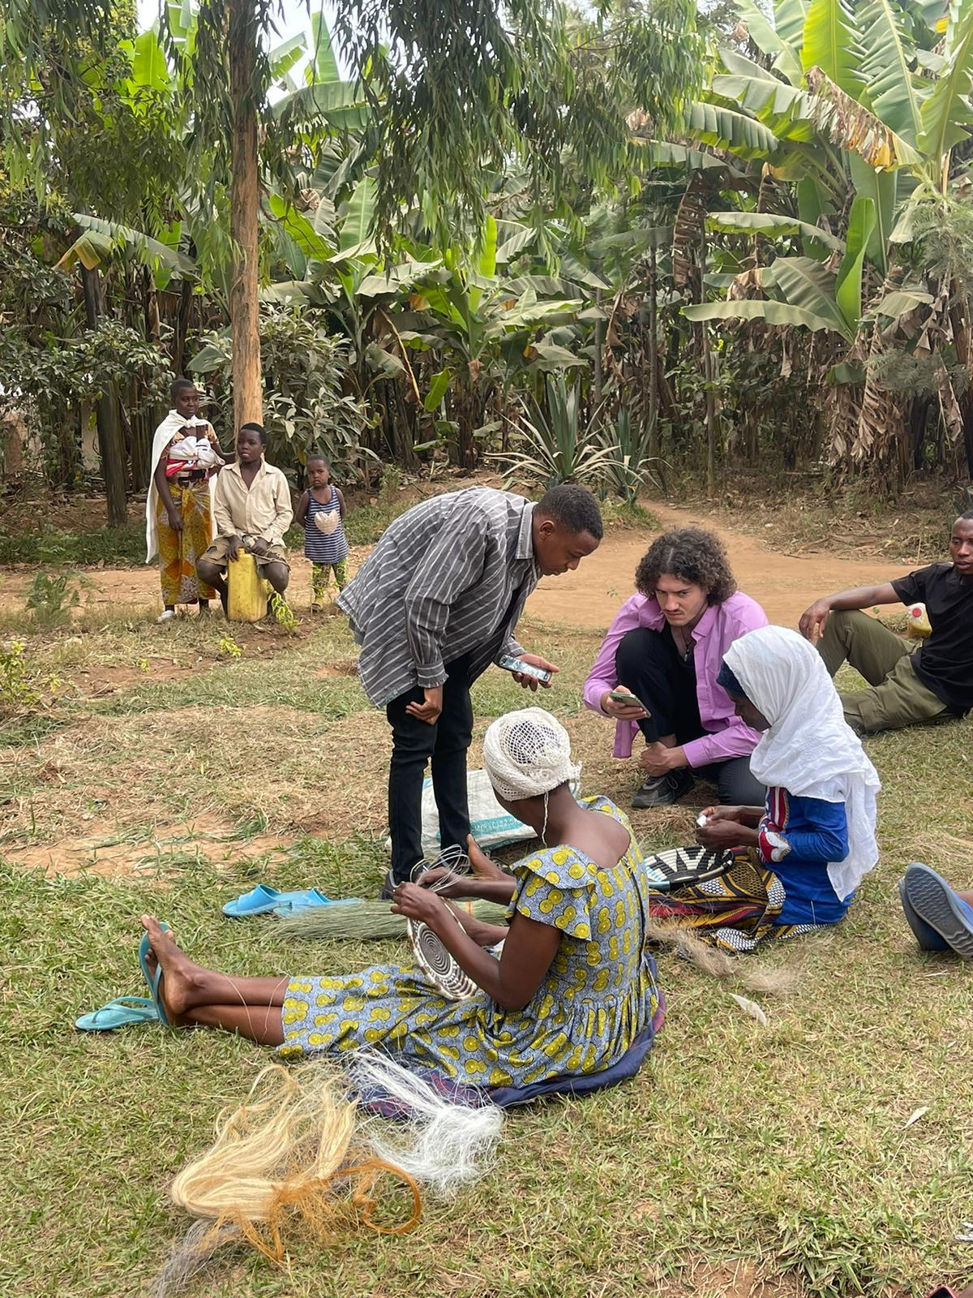
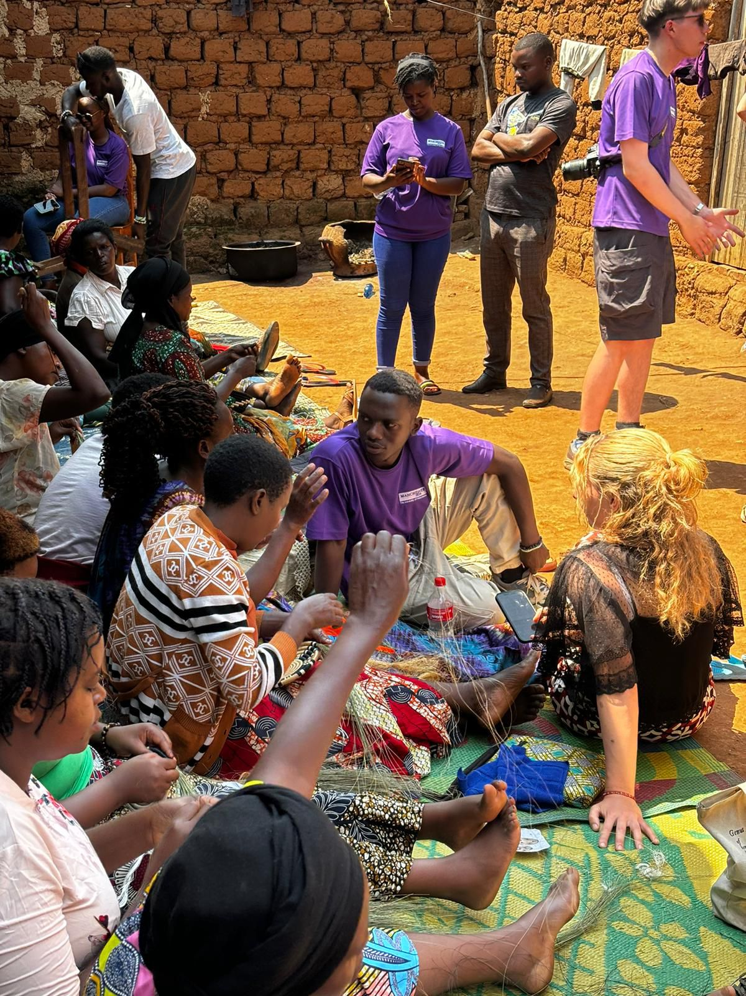
INTERVIEWS!
OUR ARTISANS
OUR PRODUCTS
OUR MISSION

Slide 10
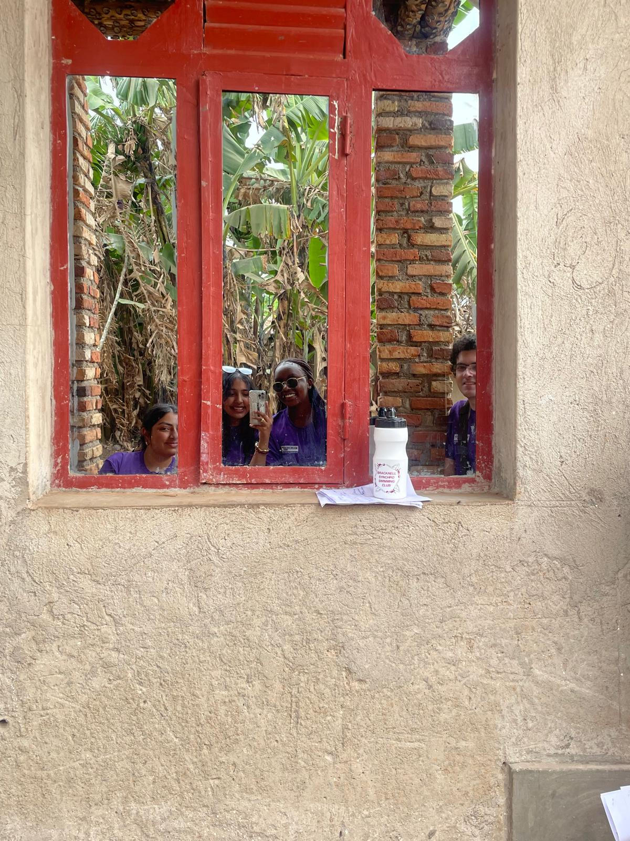
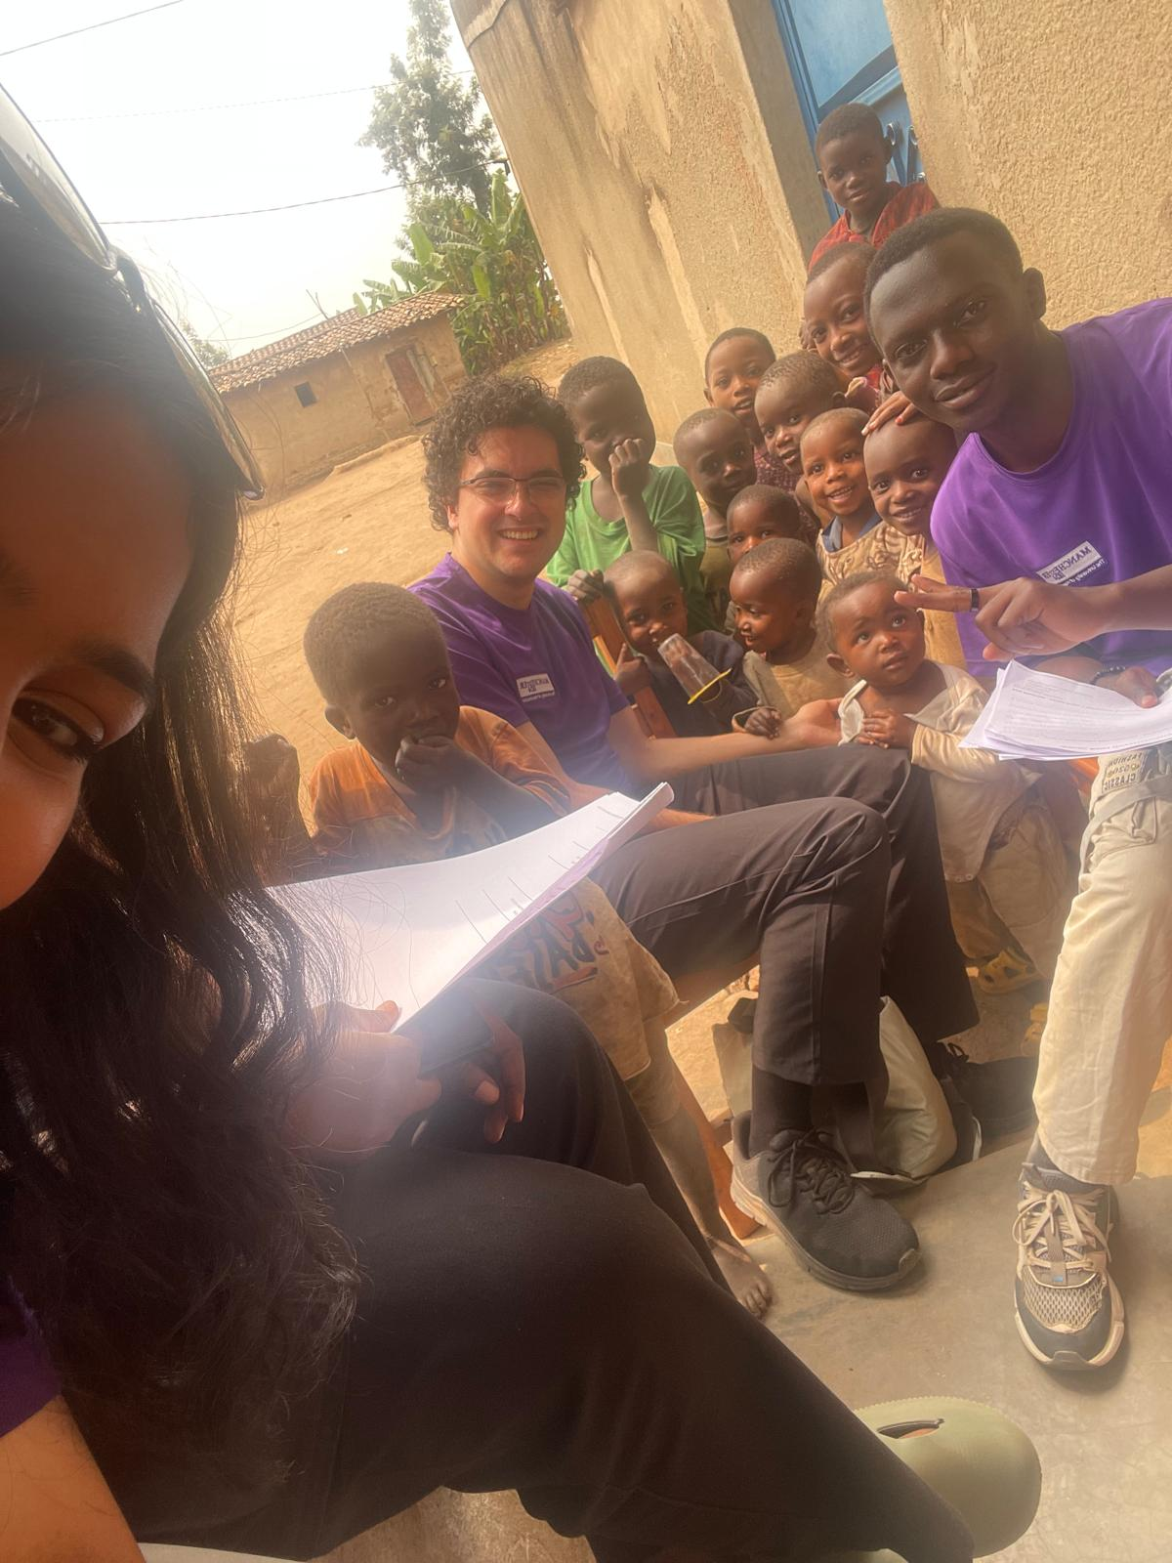
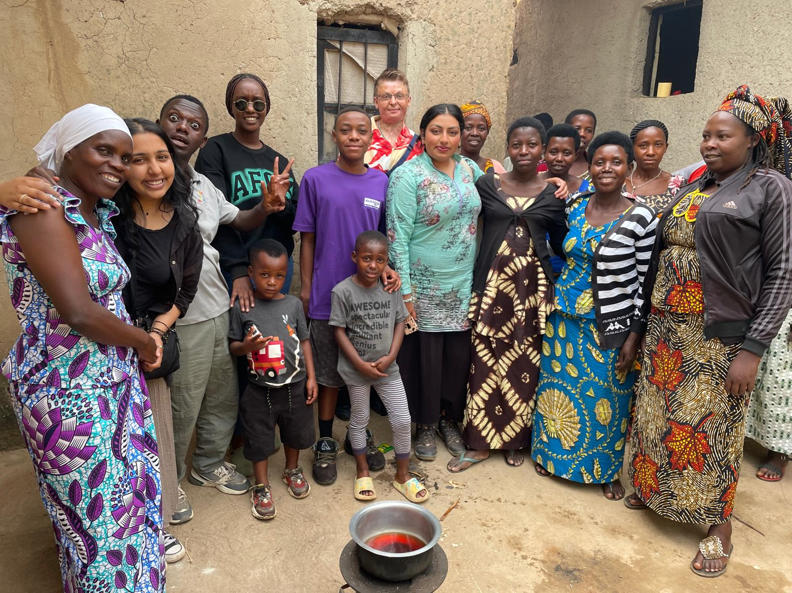
SAY 'CHEESE' :D
OUR ARTISANS
OUR PRODUCTS
OUR MISSION

Slide 11
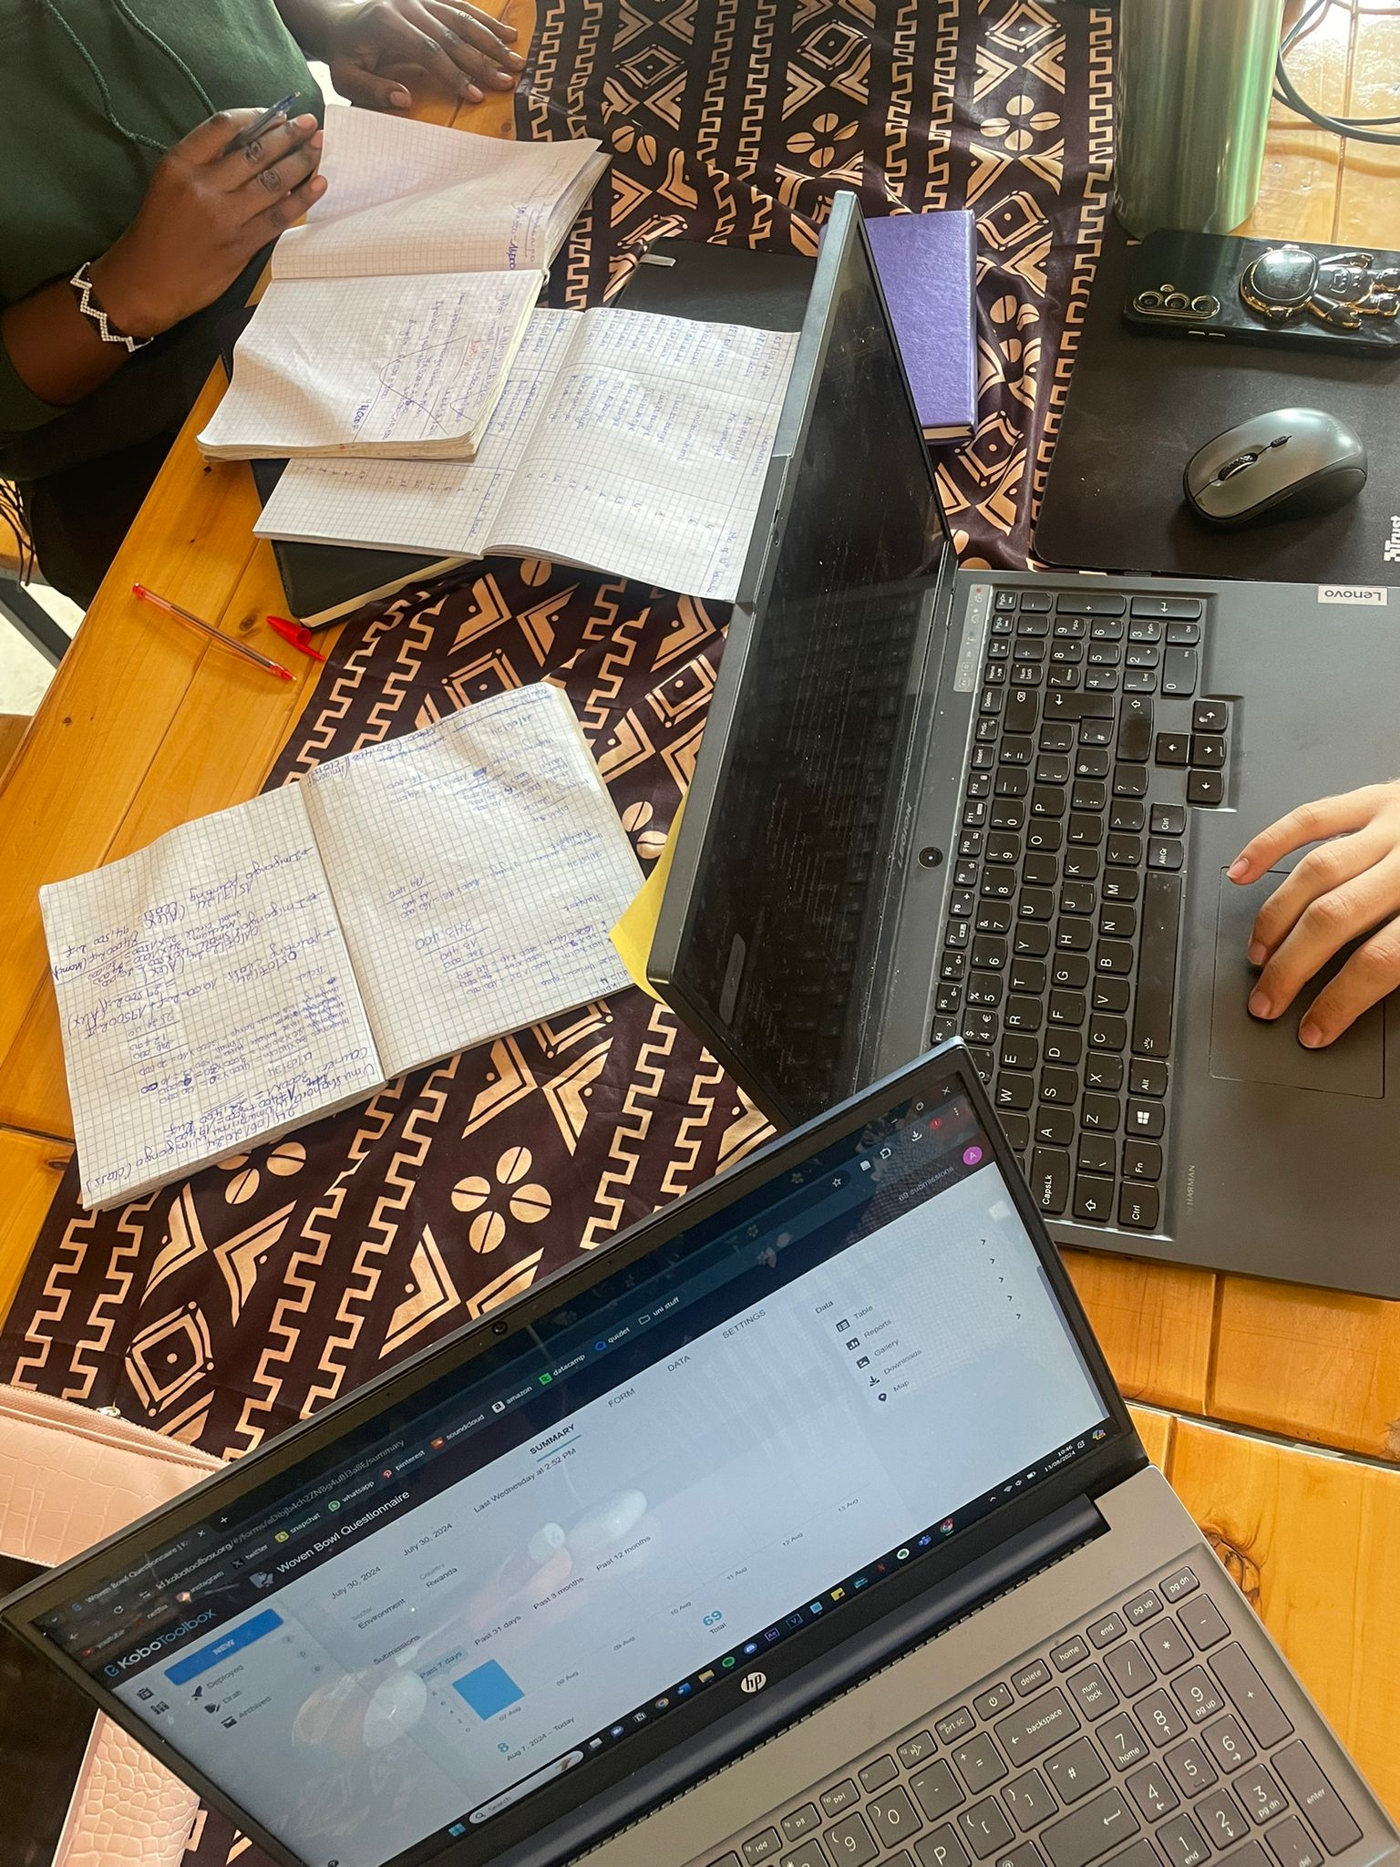
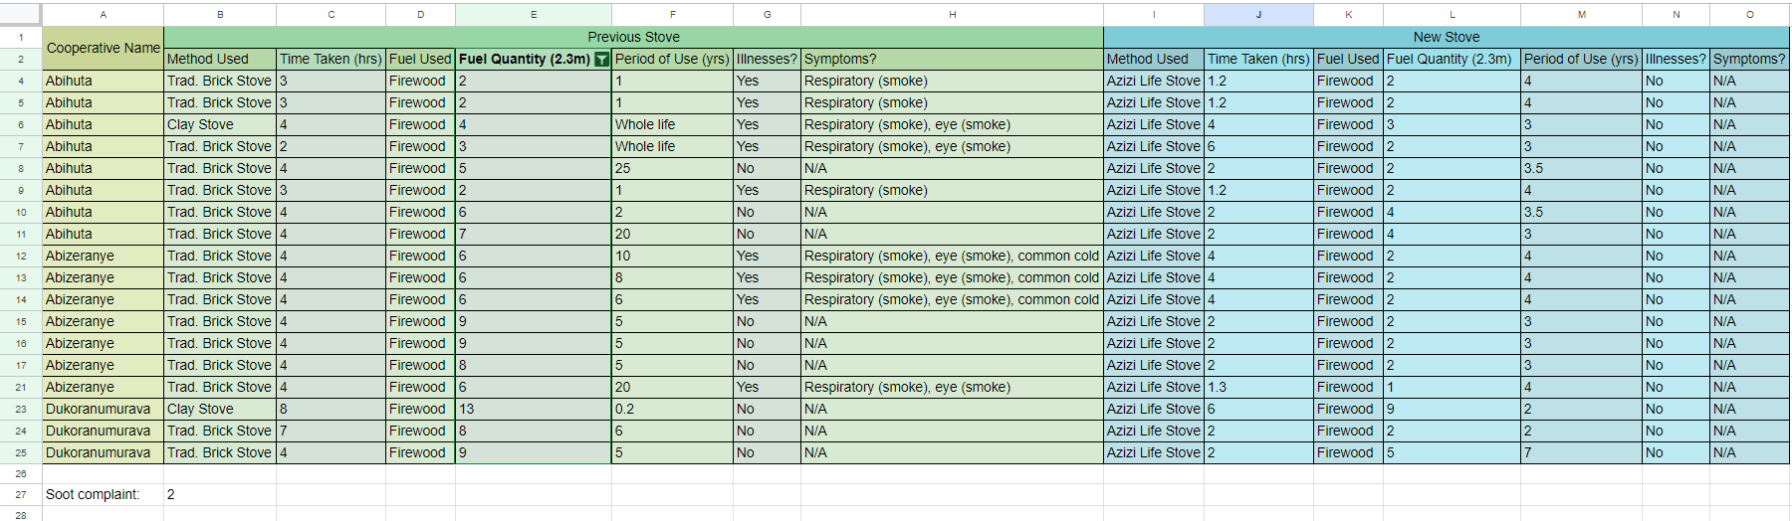
CRUNCHING THE NUMBERS 💪
OUR ARTISANS
OUR PRODUCTS
OUR MISSION
ONCE THE DATA WAS COLLECTED, WE INPUTTED THEM INTO SPREEDSHEETS AND BEGAN PROCESSING...

Slide 12
USEFUL, BUT...
OUR ARTISANS
OUR PRODUCTS
OUR MISSION
TIME LIMITATIONS
UNABLE TO REACH MORE COOPERATIVES, PARTICULARLY THOSE FURTHER AWAY AS THEY WOULD USE MORE CARBON-EMITTING TRANSPORT
UNABLE TO INTERVIEW MIXED COOPERATIVES
QUANTITY AND INTERPRETATION OF DATA
INTERVIEW LIMITATIONS
HAWTHORNE EFFECT
LACK OF SPECIFIC QUANTITIES
ARTISANS MAKE BOWLS AT AZIZI LIFE
SOME BOWLS ARE MADE BUT NOT UP TO STANDARD AND SO ARE NOT SOLD
LACK OF SPECIFIC RECORDS AND RESOURCES

Slide 13
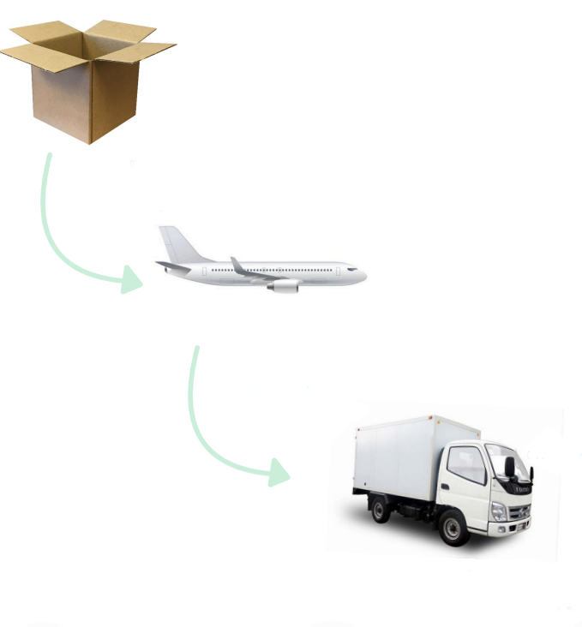
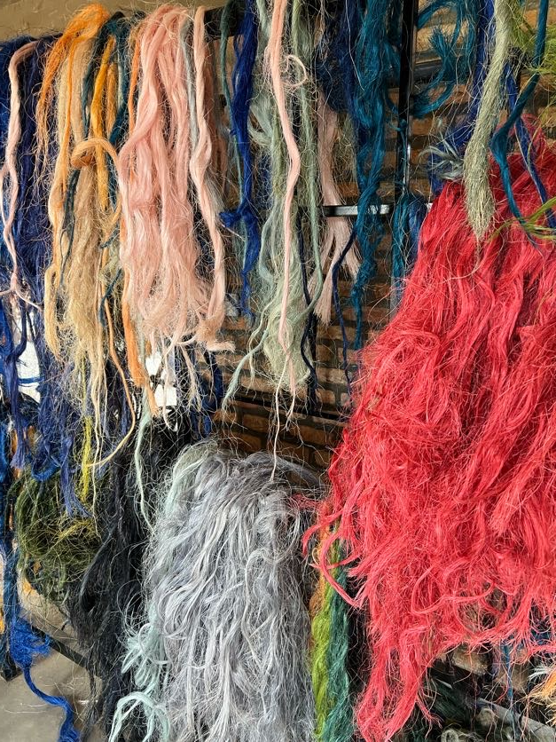
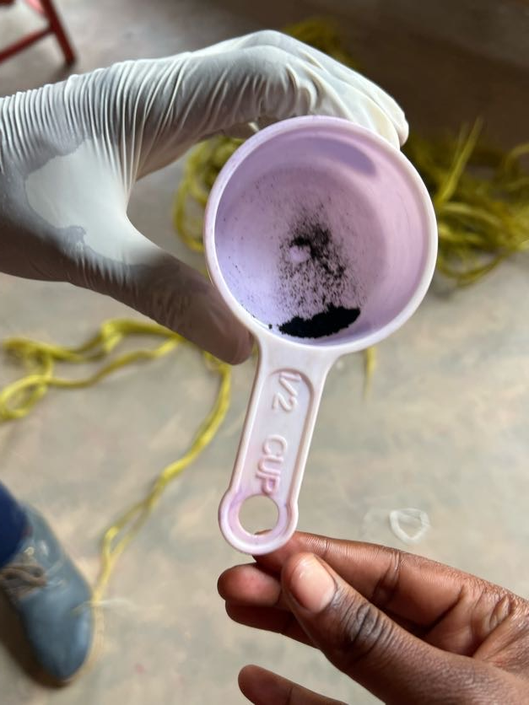
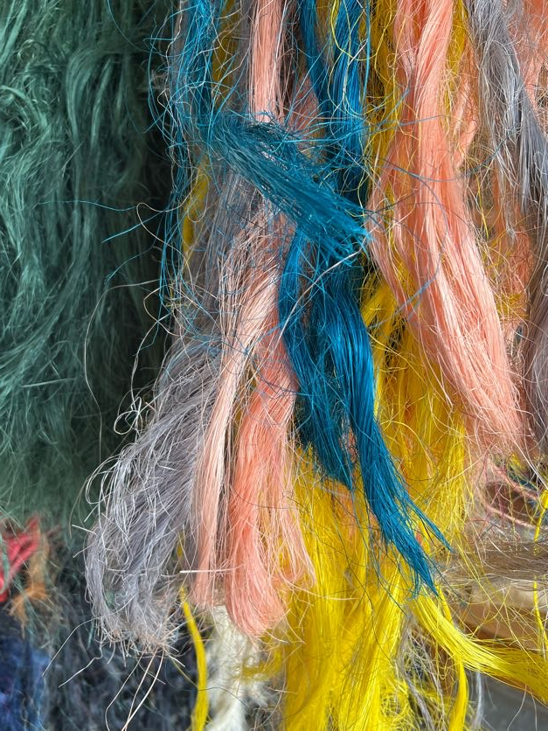
DYEING PROCESS: AZIZI LIFE
OUR ARTISANS
OUR PRODUCTS
OUR MISSION
THREE DYE COLOURS ARE BOUGHT FROM BUBANKS:
RED
GOLDEN YELLOW
BLUE
IMPORTED FROM SOUTH KOREA TO KENYA, WHERE IT THEN TRAVELS BY BUS TO AZIZI LIFE IN RWANDA.

Slide 14
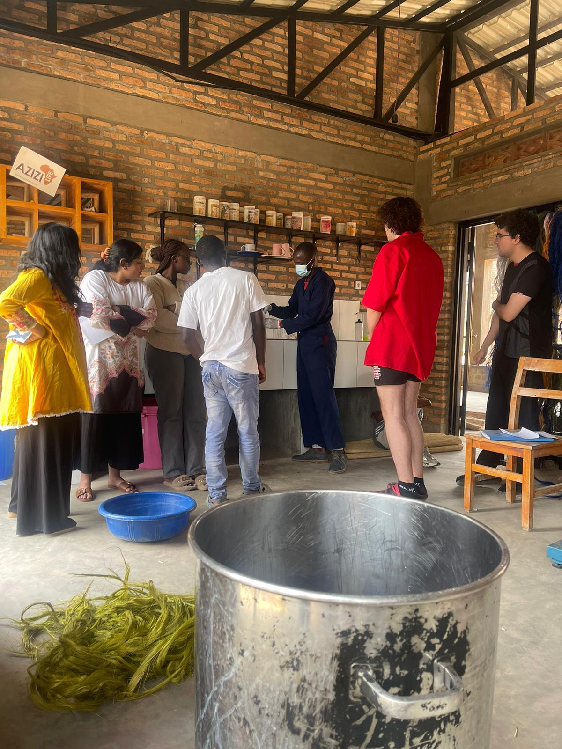
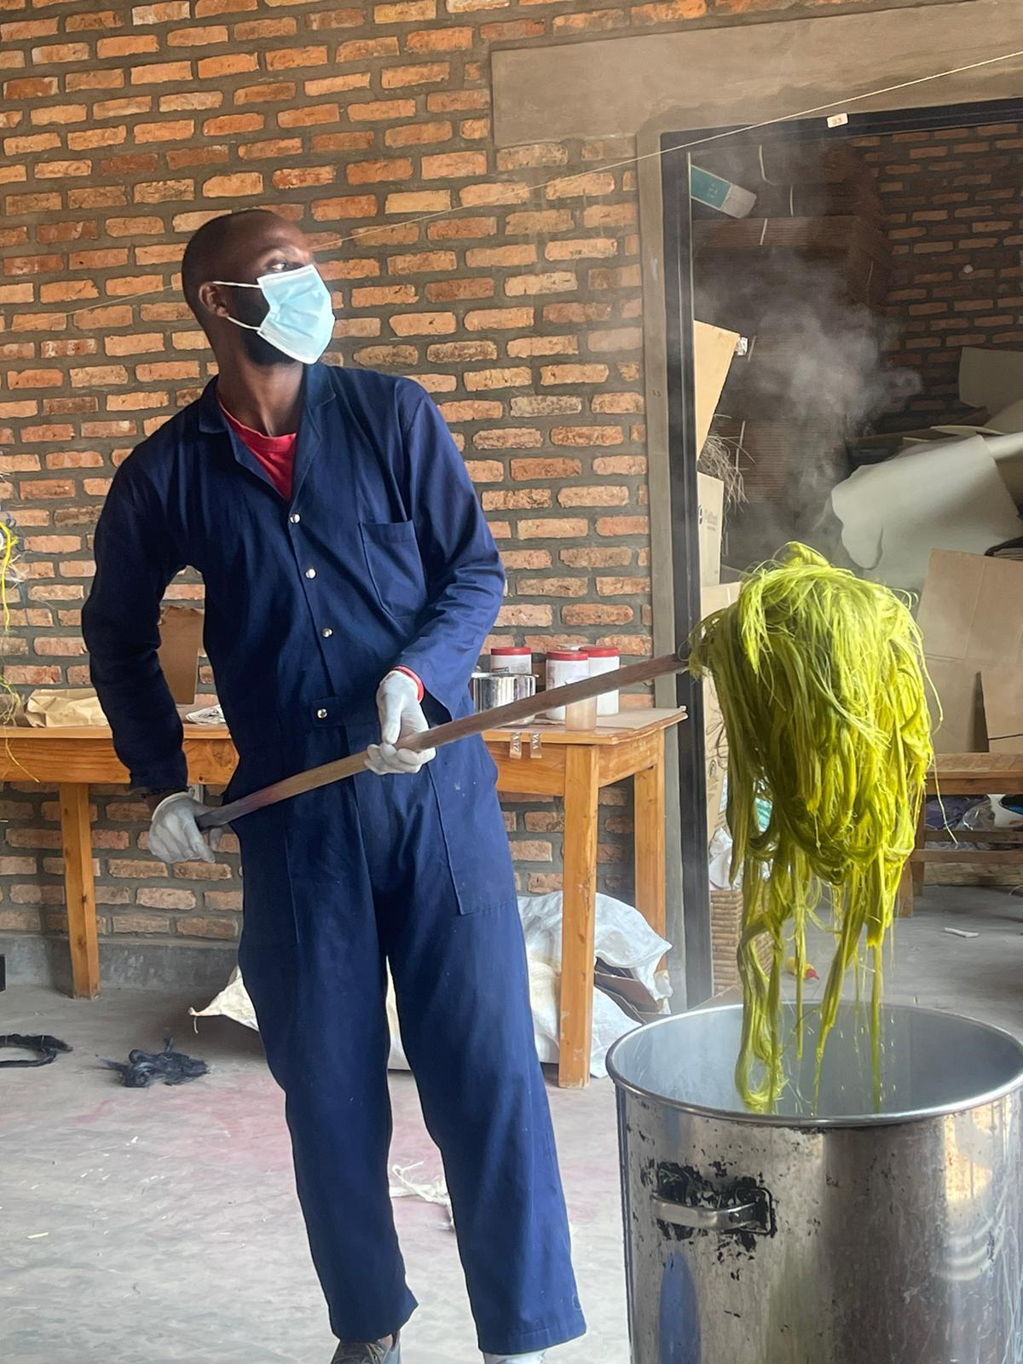
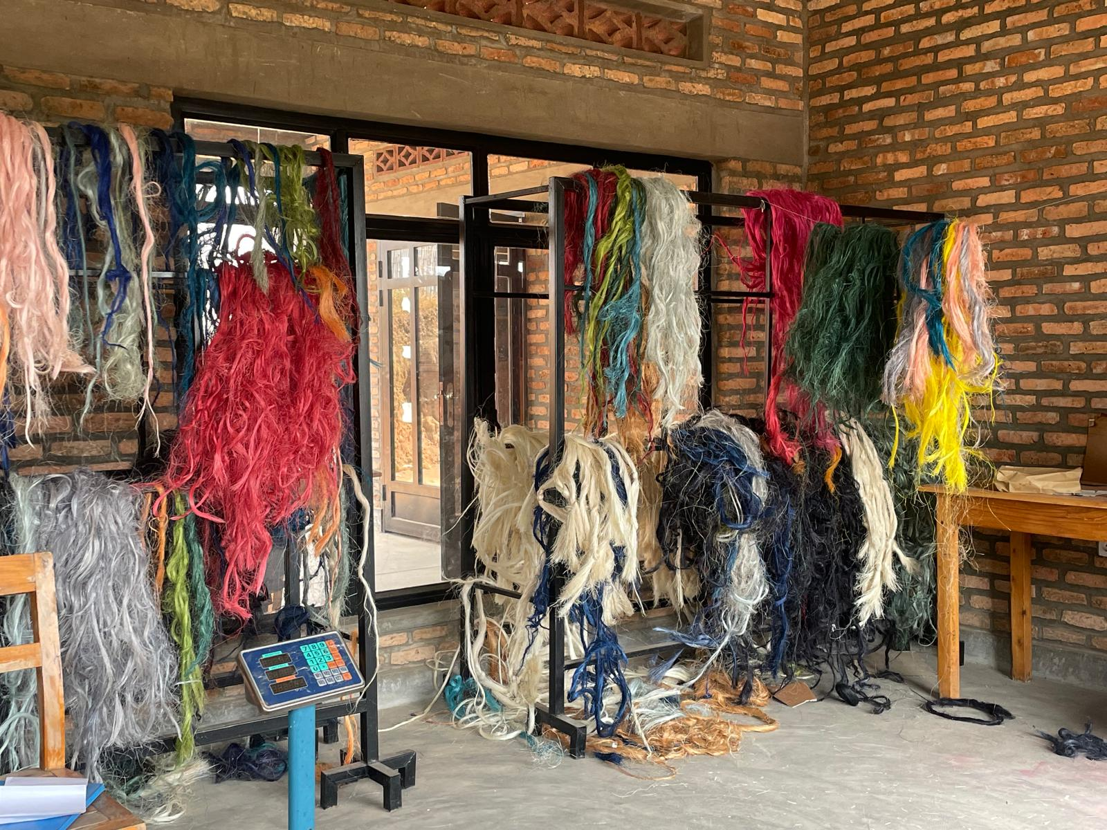
DYEING PROCESS: AZIZI LIFE (CONT.)
OUR ARTISANS
OUR PRODUCTS
OUR MISSION
AZIZI LIFE USES A GAS STOVE FOR THE DYEING PROCESS

Slide 15
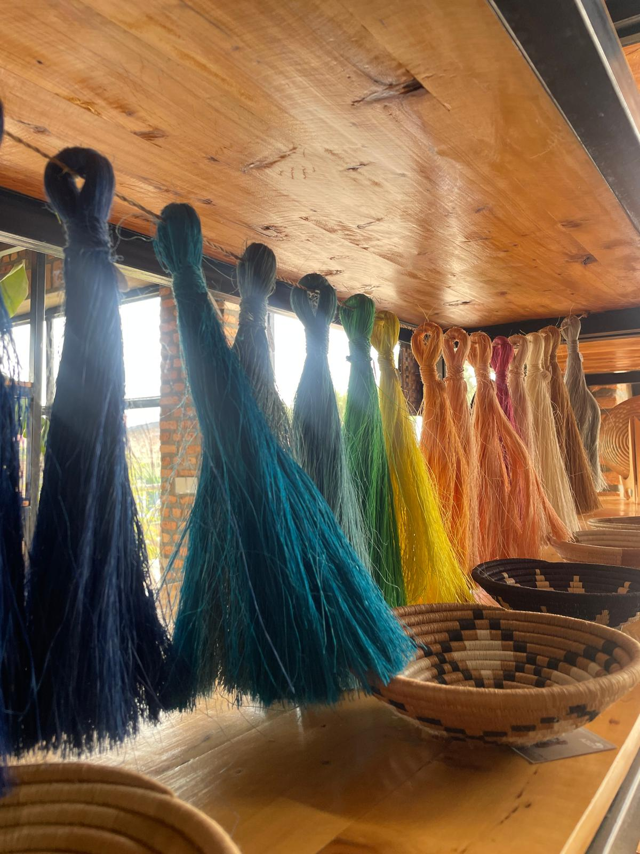
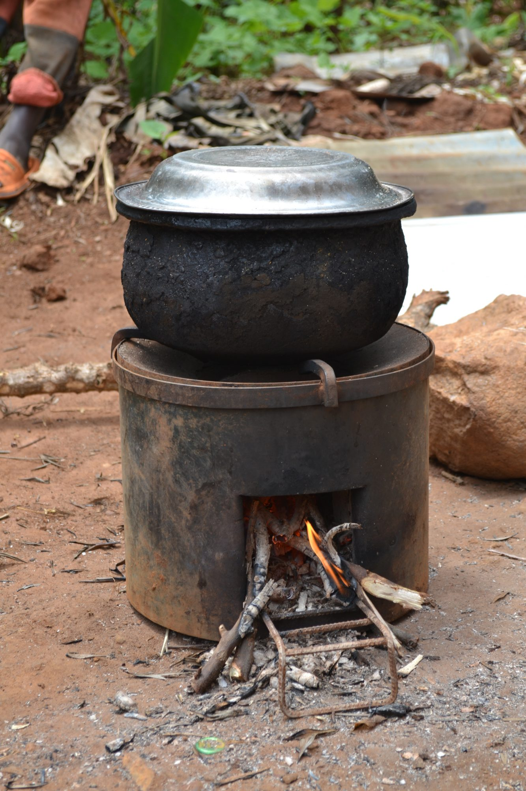
DYEING PROCESS: ARTISANS
OUR ARTISANS
OUR PRODUCTS
OUR MISSION
THE LOCAL ARTISANS SOURCE THEIR DYE FROM A LOCAL SELLER AND USE FIREWOOD STOVES FOR THEIR DYEING PROCESS.

Slide 16

CARBON BREAKDOWN OF THE 12” WOVEN BOWL
OUR ARTISANS
OUR PRODUCTS
OUR MISSION
BUYING SISAL:
0.26 KG/CO2e
DELIVERING
THE BOWL TO AZIZI LIFE: 0.23 KG/CO2e
COLLECTING
SISAL: 0 KG/CO2e
DYEING
SISAL: 5.09 KG/CO2e
CULTIVATING
SISAL: N/A KG/CO2e
RECEIVING DYED
SISAL FROM AZIZI LIFE: 0.18 KG/CO2e
BUYING FOREST GRASS: 0.11 KG/CO2e
BUYING DYED
SISAL: 0.36 KG/CO2e
CULTIVATING
FOREST GRASS: N/A KG/CO2e
COLLECTING
FOREST GRASS: 0 KG/CO2e

Slide 17

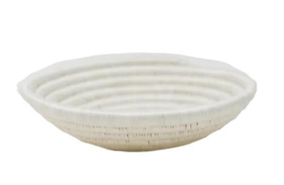
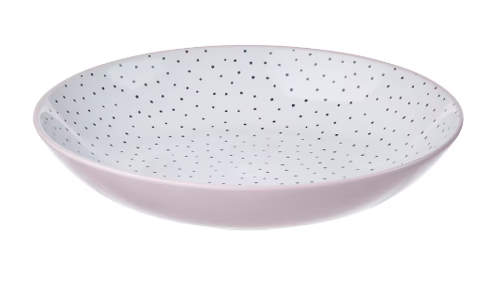
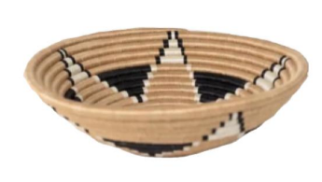
TO COMPARE:
OUR ARTISANS
OUR PRODUCTS
OUR MISSION
= 0.6 KG/CO2e
= 0.91 KG/CO2e
= 6.23 KG/CO2e

Slide 18

OFF TO PENSYLVANIA!
OUR ARTISANS
OUR PRODUCTS
OUR MISSION
0.04 KG/CO2e
4.11 KG/CO2e
THE 12” BOWLS ARE
FLOWN FROM KIGALI
AIRPORT, STOP OVER
IN BRUSSELS (BRU),
THEN CONTINUES TO
PHILADELPHIA
INTERNATIONAL
AIRPORT (PHL)
THE 12” BOWLS ARE
SHIPPED 15 TO A
BOX, WITH AN AVERAGE OF 100 BOWLS
TAKEN BY BUS 64KM
TO KIGALI AIRPORT
THE 12” BOWLS ARE
PACKED 15 TO A 33 x 33 x 33 CM CARDBOARD BOX WITH NO ADDITIONAL PACKAGING
THE 12” BOWLS ARE
TRANSPORTED TO THE
WAREHOUSE IN
PHILADELPHIA VIA A
GOODS TRUCK.
= 4.573 KG/CO2e
0.003 KG/CO2e
0.42 KG/CO2e

Slide 19
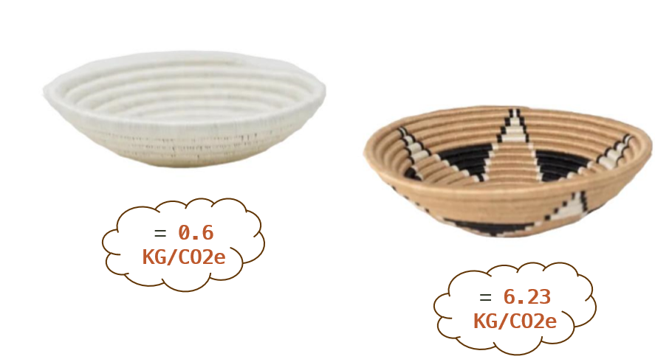
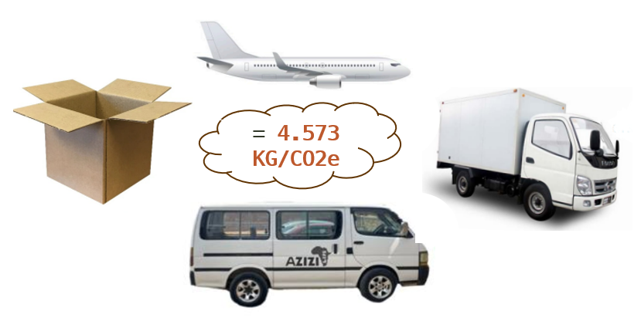
OUR RESULTS...
OUR ARTISANS
OUR PRODUCTS
OUR MISSION
+
= 5.17-10.8 KG/CO2e

Slide 20
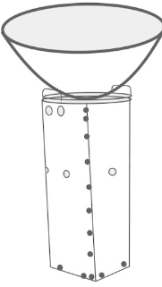
CARBON BREAKDOWN OF THE FUEL-EFFICIENT STOVE
OUR ARTISANS
OUR PRODUCTS
OUR MISSION
 | TRADITIONAL STOVE | AZIZI LIFE STOVES
AVERAGE TIME TAKEN | 3.91 HOURS | 2.81 HOURS
AMOUNT OF FUEL USED PER DAY | 10.5 KG | 5.25 KG
DAILY CO2e EMISSIONS | 18.06 KG/DAY | 9.03 KG/DAY
= 9.03 KG/CO2e SAVED PER DAY

Slide 21
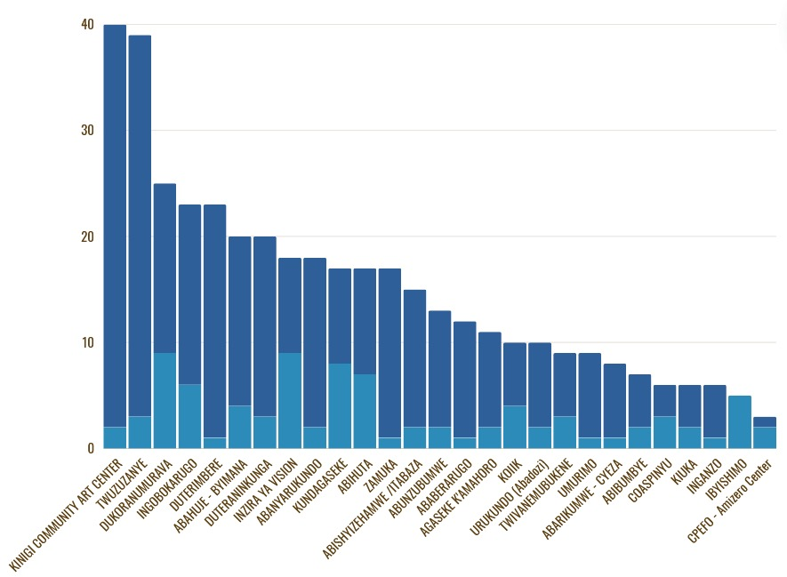
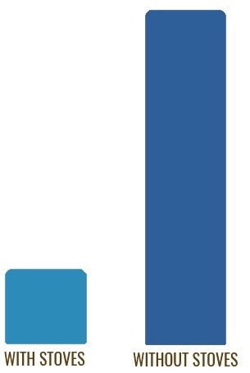
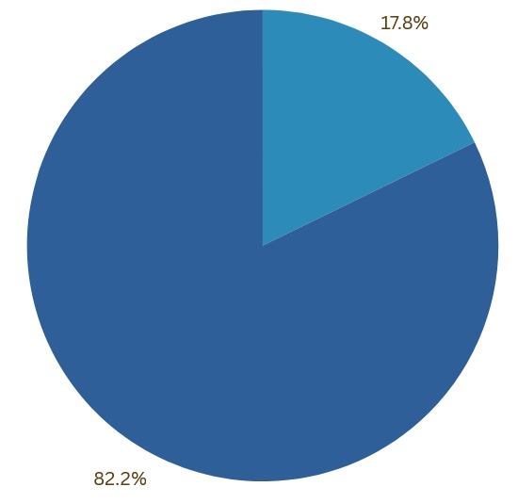
INDIVIDUALS WITH(OUT) STOVES
OUR ARTISANS
OUR PRODUCTS
OUR MISSION
WITH STOVES
WITHOUT STOVES

Slide 22




THE WATER FILTERS...
OUR ARTISANS
OUR PRODUCTS
OUR MISSION
INCREASING PERCENTAGE OF POPULATION USING SAFELY MANAGED DRINKING WATER SERVICES
UNFORTUNATELY, THERE WERE ONLY 3 OUT OF 69 INTERVIEWEES THAT HAD WATER FILTERS.
ACCORDING TO PURIFAAYA, THE AVERAGE CO2e SAVED PER DAY PER FILTER IS 9.3KG
HOWEVER, THE INFORMATION FROM THE COMPANY HAS BEEN USING THE SAME NUMBERS SINCE 2016 AND SO WAS CONSIDERED UNRELIABLE.
THEREFORE, WE HAVE DECIDED TO DISREGARD THE CARBON BREAKDOWN OF THE FILTERS.
WOOD NOT BURNED FROM DOMESTIC CONSUMPTION
2.0 TONS OF WOOD SAVED PER FILTER PER YEAR
EMISSION REDUCTION
2.5 TONS OF CO2 SAVED PER FILTER PER YEAR

Slide 23
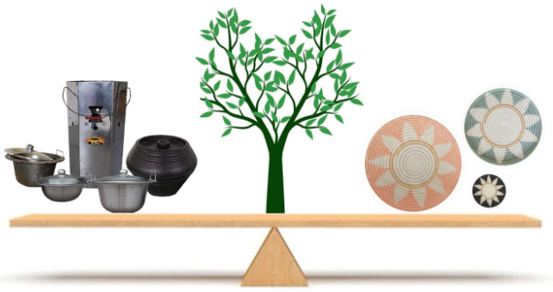
STRIVING FOR CARBON NEUTRALITY
OUR ARTISANS
OUR PRODUCTS
OUR MISSION
AND
IF 1 STOVE SAVES 9.03 KG/CO2e...
IF 1 BOWL CREATES 5.17-10.8 KG/CO2e...
1 STOVE NEUTRALISES 1 BOWL

Slide 24
TO CONCLUDE...
OUR ARTISANS
OUR PRODUCTS
OUR MISSION
PRODUCTION OF ONE 12” WOVEN BOWEL CREATES 10.81kg CO2e.
PROVIDING AN ARTISAN WITH AN AZIZI LIFE STOVE SAVES 9.03kg CO2e PER DAY.
ONE ARTISAN USING AN AZIZI LIFE STOVE IN PLACE OF A TRADITIONAL STOVE FOR ONE DAY ALMOST OFFSETS THE PRODUCTION OF A WHOLE 12” BOWL.
668 BOWLS WERE SOLD THIS PAST YEAR. THIS IS 7221.08kg CO2e PER YEAR.
JUST 2 AZIZI LIFE STOVES BEING USED IN PLACE OF THE TRADITIONAL BRICK STOVES EVERYDAY, OFFSETS THE CARBON EMISSIONS FROM THE PRODUCTION OF EVERY 12 INCH WOVEN BOWL MADE BY AZIZI LIFE IN A YEAR.
INCREASING THE NUMBER OF THESE STOVES WITHIN THE COOPERATIVES IS AZIZI LIFE’S SOLUTION TO CARBON NEUTRALITY.

Slide 25
IDEAS FOR FUTURE VOLUNTEERS:
OUR ARTISANS
OUR PRODUCTS
OUR MISSION
REDUCE THE CARBON EMISSIONS FROM THE DYEING PROCESS
PROVIDE THE ARTISANS WITH INFORMATION ABOUT CARBON EMISSIONS
MAKE ACCESSIBILITY TO STOVES FOR THE ARTISANS EASIER
INCREASE THE NUMBER OF WATER FILTER SALES
CALCULATE THE CARBON FOOTPRINT OF BEE WAX/HONEY PRODUCTS
CALCULATE THE CARBON FOOTPRINT OF THE CAFÉ
CALCULATE THE CARBON FOOTPRINT OF EACH EXPERIENCE DAY
CALCULATE THE TOTAL CARBON FOOTPRINT OF AZIZI LIFE
CALCULATE NUMBER OF SOLAR PANELS REQUIRED TO ACHIEVE CARBON NEUTRALITY AT AZIZI LIFE

Slide 26
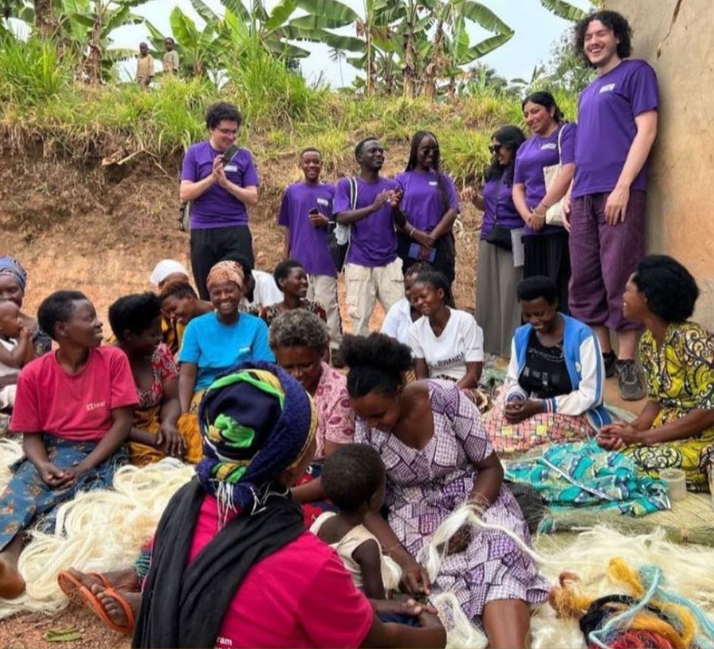
THANK YOU! ANY QUESTIONS?

